Slide 1

Large-scale clustering
Shuqian Xie
Zhimao Lin
Weichuan Deng

Slide 2
Content
Introduction
Hierarchical Clustering
Algorithm
Example
K-means Clustering
Algorithm
Map-Reduce
Example
Reference

Slide 3
Introduction

Slide 4
Clustering
Clustering is the task of dividing the population or data points into a number of groups such that data points in the same groups are more similar to other data points in the same group and dissimilar to the data points in other groups. It is basically a collection of objects on the basis of similarity and dissimilarity between them.
Source:https://www.geeksforgeeks.org/clustering-in-machine-learning/
Notes:
Clustering is the task of dividing the population or data points into a number of groups such that data points in the same groups are more similar to other data points in the same group and dissimilar to the data points in other groups. It is basically a collection of objects on the basis of similarity and dissimilarity between them.

Slide 5
Example
A rental store wish to understand preferences of their customers to scale up your business.
Is it possible for you to look at details of each customer and devise a unique business strategy for each one of them? Definitely not. But, what you can do is to cluster all of your customers into say 10 groups based on their purchasing habits and use a separate strategy for customers in each of these 10 groups. And this is what we call clustering.

Slide 6
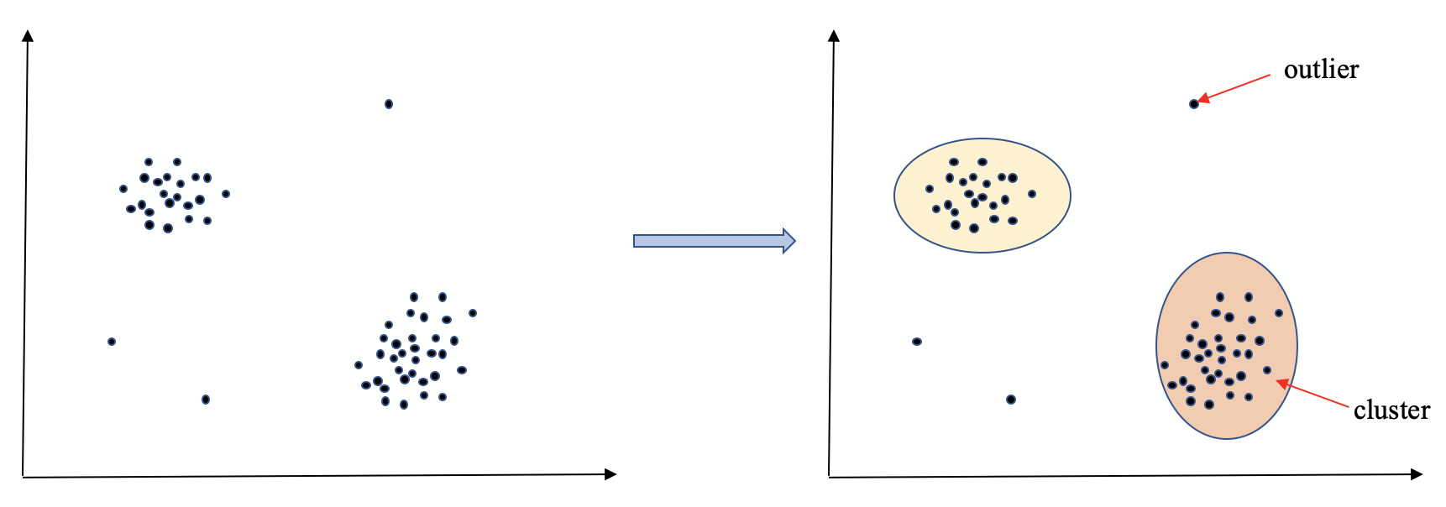
Example
Notes:
The data points in the graph below clustered together can be classified into one single group. We can distinguish the clusters, and we can identify that there are 2 clusters in the below picture.

Slide 7
Applications
For example:
Human genetic clustering
Grouping of shopping items
E-commerce
Social network analysis
Recommender systems
Crime analysis
image segmentation
Notes:
Human genetic clustering
The similarity of genetic data is used in clustering to infer population structures.
Grouping of shopping items:
Clustering can be used to group all the shopping items available on the web into a set of unique products. For example, all the items on amazon can be grouped into unique products.
E-commerce
Classifying customers by purchase history or clickstream activity.
Social network analysis:
In the study of social networks, clustering may be used to recognize communities within large groups of people.
Recommender systems
Recommender systems are designed to recommend new items based on a user's tastes. They sometimes use clustering algorithms to predict a user's preferences based on the preferences of other users in the user's cluster.
Crime analysis
Cluster analysis can be used to identify areas where there are greater incidences of particular types of crime. By identifying these distinct areas or "hot spots" where a similar crime has happened over a period of time, it is possible to manage law enforcement resources more effectively.

Slide 8
Challenges in the Large Scale Setting
Clustering seems easy when the data size is small with only 2 dimensions.
But in most cases, the applications involve high-dimensional space.
Many popular clustering algorithms are inherently difficult to parallelize, and inefficient at large scales.

Slide 9
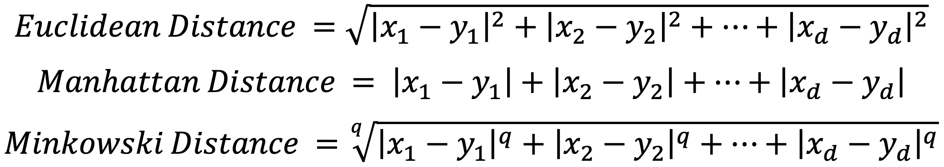
Distance Measurement
Euclidean Space
Let's consider d-dimensional Euclidean space. Given two random points
Non-Euclidean Space
cosine distance: vectors
Jaccard distance: sets
edit distance: strings

Slide 10
Hierarchical Clustering

Slide 11
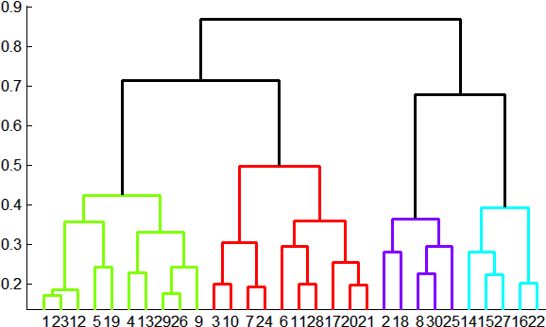
Hierarchical Clustering
Agglomerative (bottom up):
Initially, each point is a cluster by itself and is the centroid of that cluster.
centroid of a cluster = average of its points
Key operation: Repeatedly combine the two “nearest” clusters into one.

Slide 12
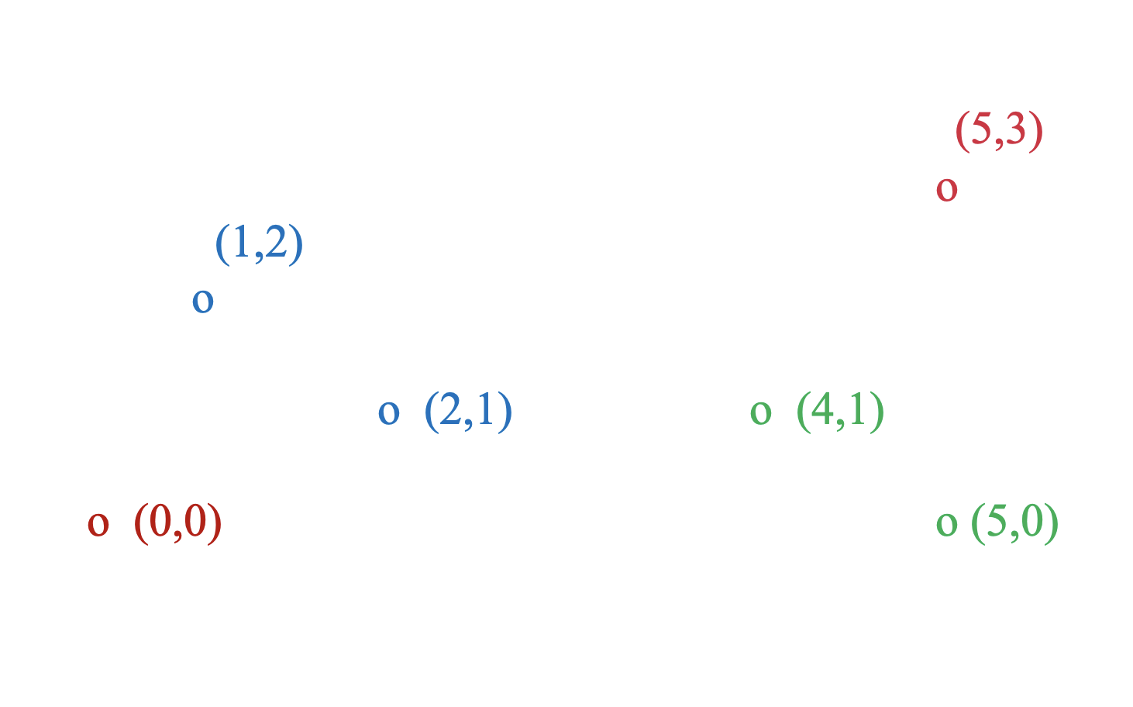
Example
Data:
o … data point
x … centroid
Dendrogram
J. Leskovec, A. Rajaraman, J. Ullman: Mining of Massive Datasets, http://www.mmds.org

Slide 13
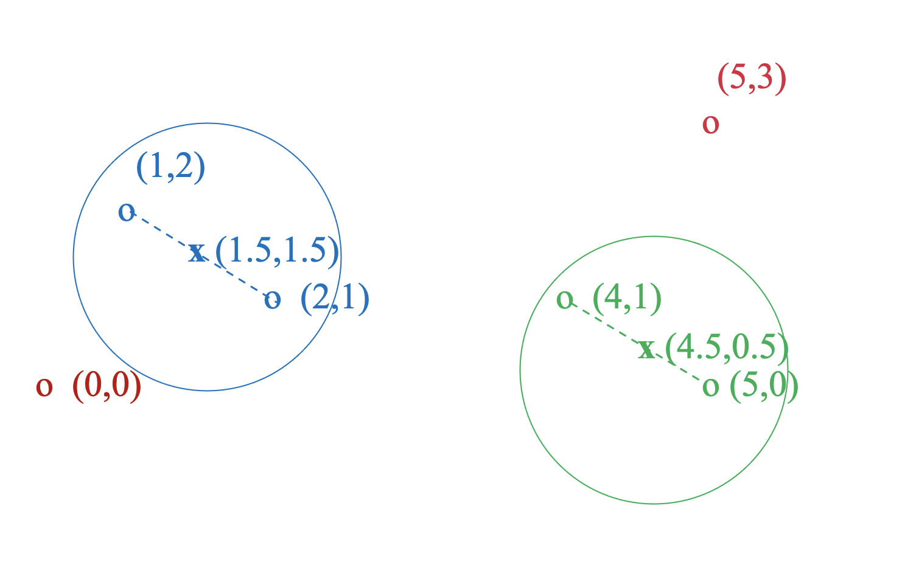
Example
Data:
o … data point
x … centroid
Dendrogram
J. Leskovec, A. Rajaraman, J. Ullman: Mining of Massive Datasets, http://www.mmds.org

Slide 14
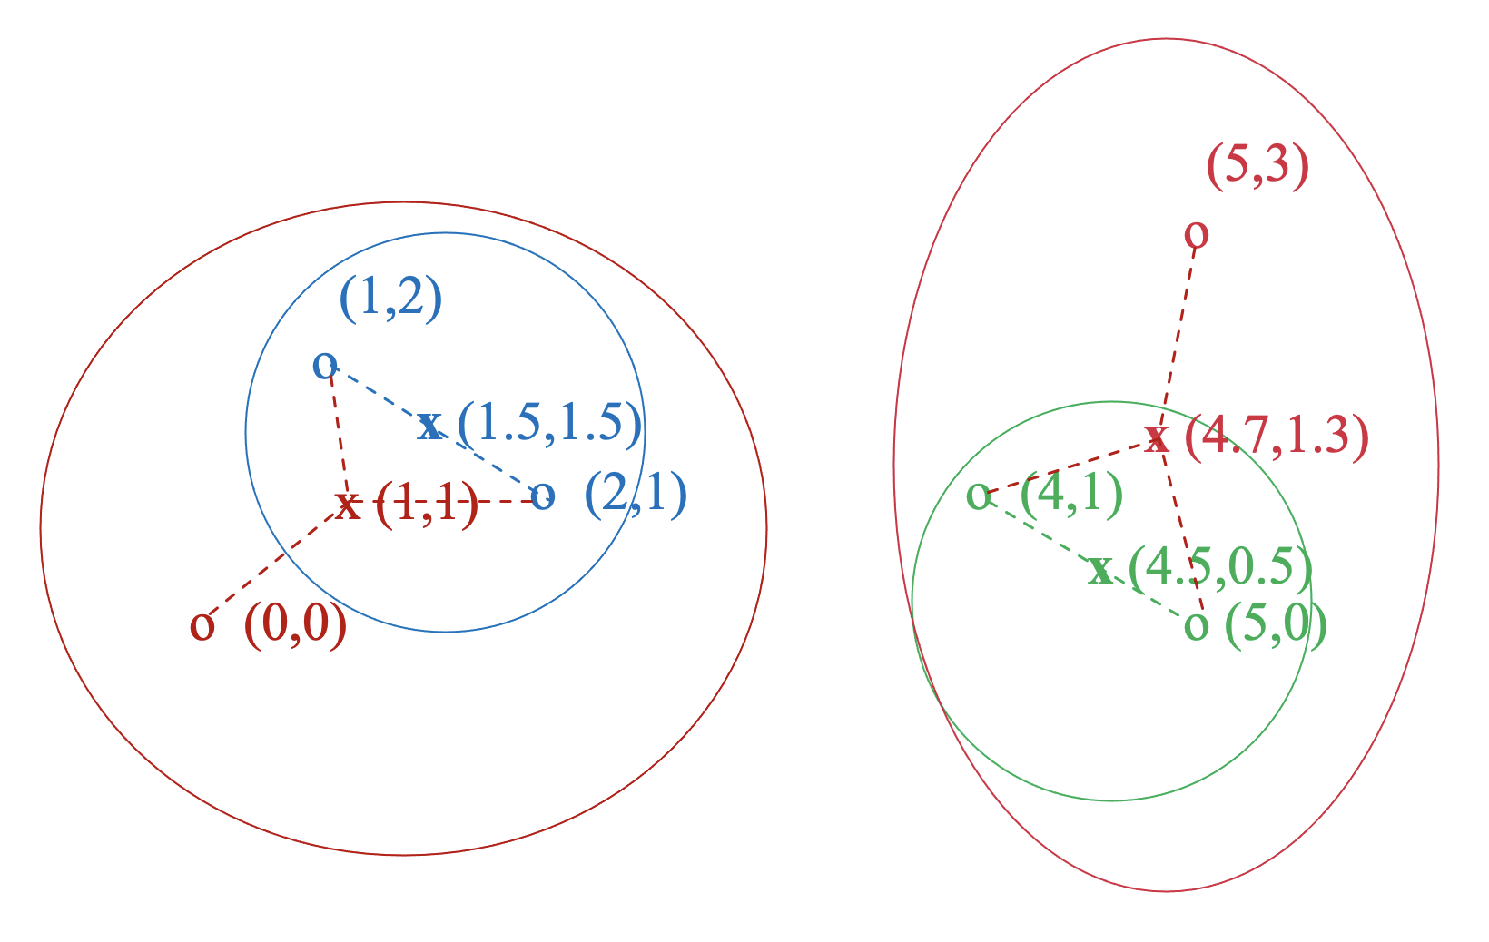
Example
Data:
o … data point
x … centroid
Dendrogram
J. Leskovec, A. Rajaraman, J. Ullman: Mining of Massive Datasets, http://www.mmds.org

Slide 15
Distance Between Two Clusters
Distance between their centroids.
Minimum of between any two points, one from each cluster.
Average distance of all pairs of points, one from each cluster.
Radius = Maximum distance between all the points and centroid.
Diameter = Maximum distance between any two points of the cluster.
Notes:
4 The radius of a cluster is the maximum distance between all the points and the centroid. Combine the two clusters whose resulting cluster has the lowest radius.
5.The diameter of a cluster is the maximum distance between any two points of the cluster. We may choose to merge those clusters whose resulting cluster has the smallest diameter.

Slide 16
Stopping Rules
Stop when we have k clusters for some predetermined k.
Continue clustering until there is only one cluster and return the tree representing the way in which all the points were combined.
If the diameter/density that results from the best merger exceeds/is below a threshold.
Stop when there is evidence that the next pair of clusters to be combined yields a bad cluster.
Notes:
4. Stop when there is evidence that the next pair of clusters to be combined yields a bad cluster. For example, we could track the average diameter of all the current clusters. As long as we are combining points that truly belong in a cluster, this average will rise gradually. However, if we combine two clusters that really don’t deserve to be combined, then the average diameter will take a sudden jump.

Slide 17
Non-Euclidean Case
The only “location” are the points themselves
i.e. no “average” of two points
Represent a cluster of many points:
clustroid = point “closest” to other points
Determine the “nearness” of clusters:
Treat clustroid as if it were centroid, when computing inter-cluster distances

Slide 18
Possible meanings of “closest”:
Smallest maximum distance to other points
Smallest average distance to other points
Smallest sum of squares of distances to other points

Slide 19
Advantages of Hierarchical Clustering
No prior information about the number of clusters is required.
Easy to understand and easy to implement
Can be used in both Euclidean space and Non-Euclidean space.

Slide 20
Disadvantages of Hierarchical Clustering
The basic algorithm for hierarchical clustering is not very efficient.
At each step, compute pairwise distances between all pairs of clusters, then merge. O(N³)
Using priority queue can reduce time to O(N² log N)
Still too expensive for really big datasets that do not fit in memory
Notes:
The disadvantage of Hierarchical clustering is that it can’t perform large-scale clustering. Because the basic algorithm for hierarchical clustering is not very efficient. At each step, compute pairwise distances between all pairs of clusters, then merge. Time complexity is O(N3). Using priority queue can reduce time complexity to O(N2log N), which is still too expensive for really big datasets that do not fit in memory.

Slide 21
Code
In R: hcluster()
In python: import scipy.cluster.hierarchy as sch
sch.linkage, sch.fcluster, sch.dendrogram
method = “complete”, “single”, “average”, “centroid”, etc

Slide 22
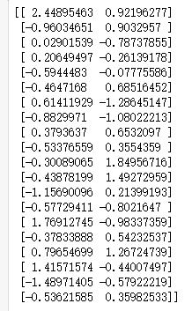
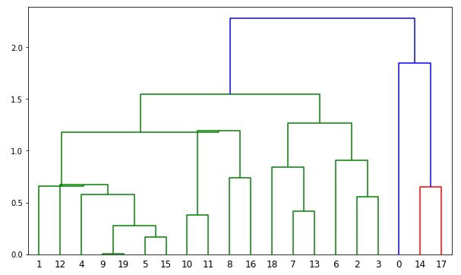
Dendrogram
Original data: Dendrogram:

Slide 23
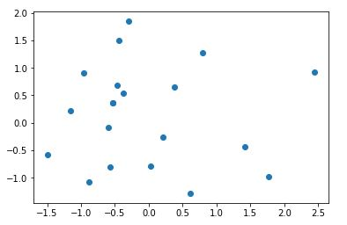
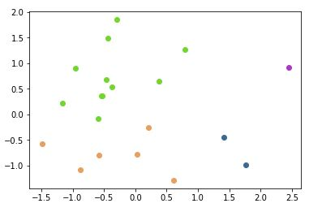
Visualization
k = 4
In python:
k_2d = 4
f_2d = sch.fcluster(linkage_2d, k_2d, 'maxclust')

Slide 24
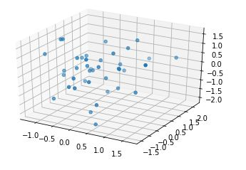
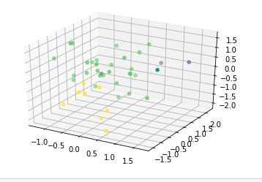
3D
k = 4
In python:
k_3d = 4
f_3d = sch.fcluster(linkage_3d, k_3d, 'maxclust')

Slide 25
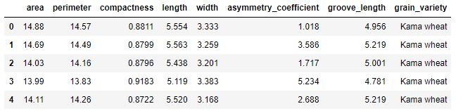
Categorical data
Convert the categorical data into dummy variable.

Slide 26
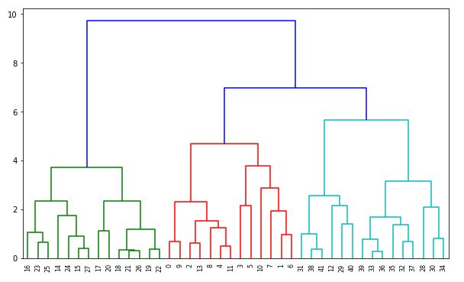
Dendrogram

Slide 27
K-means Clustering

Slide 28
K-means Algorithms
Picking k initial centroids of cluster
For each point place it in the cluster whose current centroid is the nearest
After all points are assigned, update the locations of centroid for each cluster
Reassign all points to their closest centroid form new clusters
Repeat 3 and 4 until convergence

Slide 29
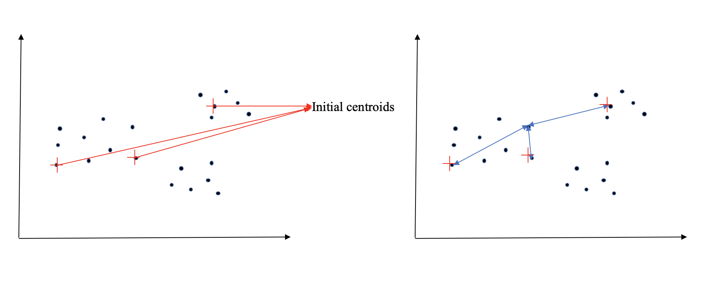
Example

Slide 30
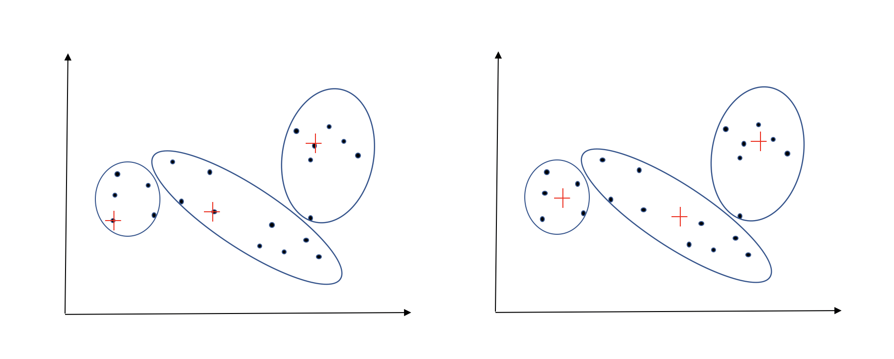
Example

Slide 31
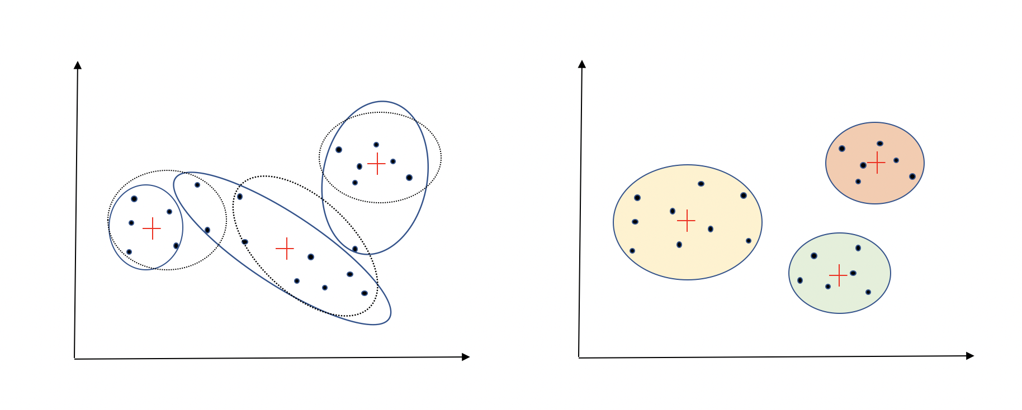
Example

Slide 32
Picking initial k points
Approach 1 : Cluster a small sample of data (e.g. hierarchical clustering) to obtain k clusters. Pick a point from each cluster (e.g. the point closest to the centroid of the cluster)
Approach 2 : Pick the “dispersed” set of points.
1. Pick the first point at random.
2. Pick the next point whose minimum distance from the selected points is as large as possible.
Repeat 2 until we have k points.
Notes:
We want to pick points that have a good chance of lying in different groups. There are two approaches.
2: Pick points that are as far away from one another as possible.

Slide 33
K-means++
Choose one center uniformly at random among the data points.
For each data point x, compute D(x), the distance between x and the nearest center that has already been chosen.
Choose one new data point at random as a new center, using a weighted probability distribution where a point x is chosen with probability proportional to D(x)^2.
Repeat Steps 2 and 3 until k centers have been chosen.
Now that the initial centers have been chosen, proceed using standard k-means clustering.

Slide 34
Getting the right k
How to select k?
Try different k, looking at the change in the average distance to centroid as k increases.
Average distance falls rapidly until convergence to get the right k.

Slide 35
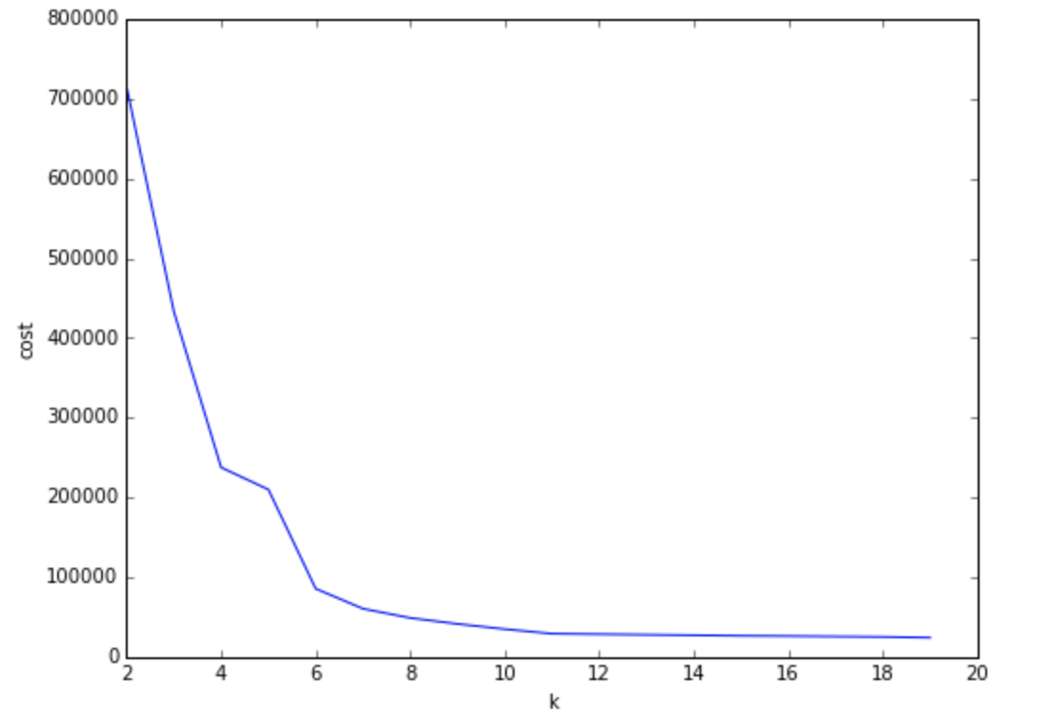
Example
The right k

Slide 36
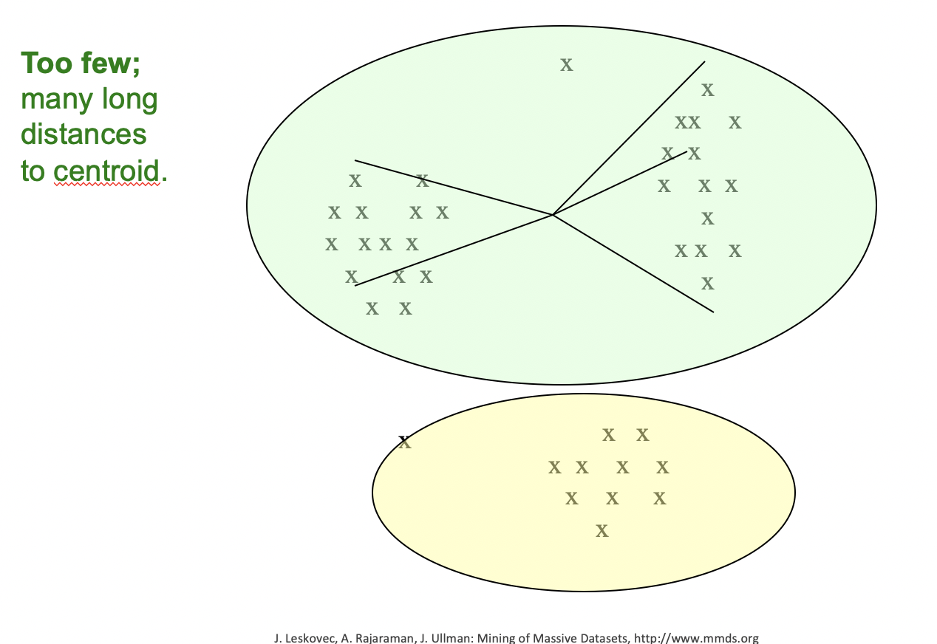
Example

Slide 37
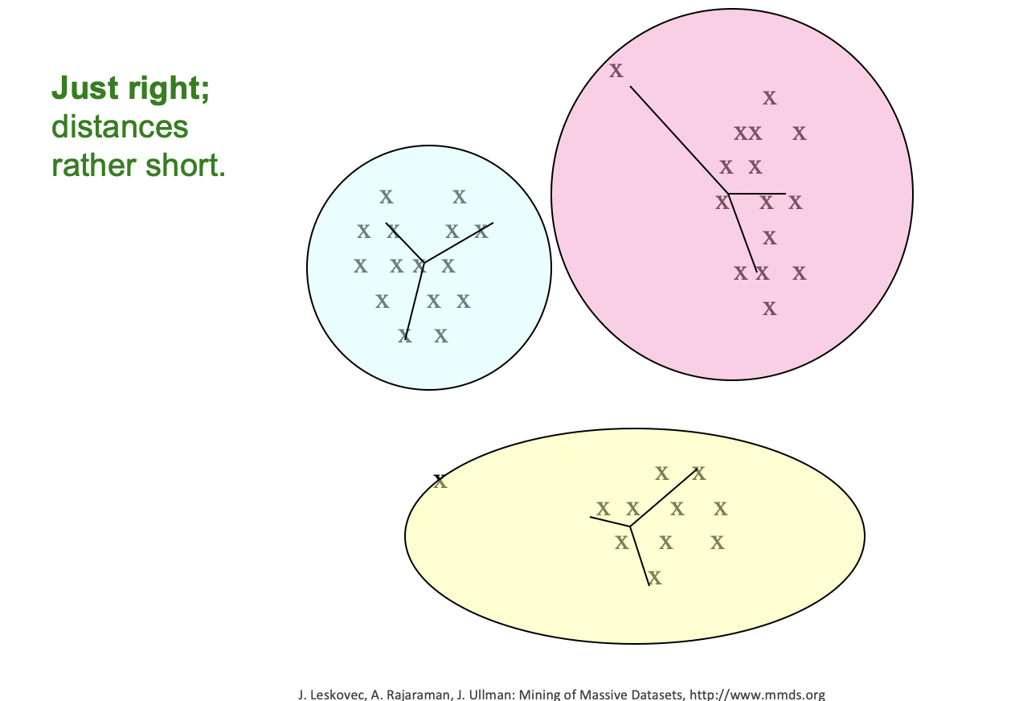
Example

Slide 38
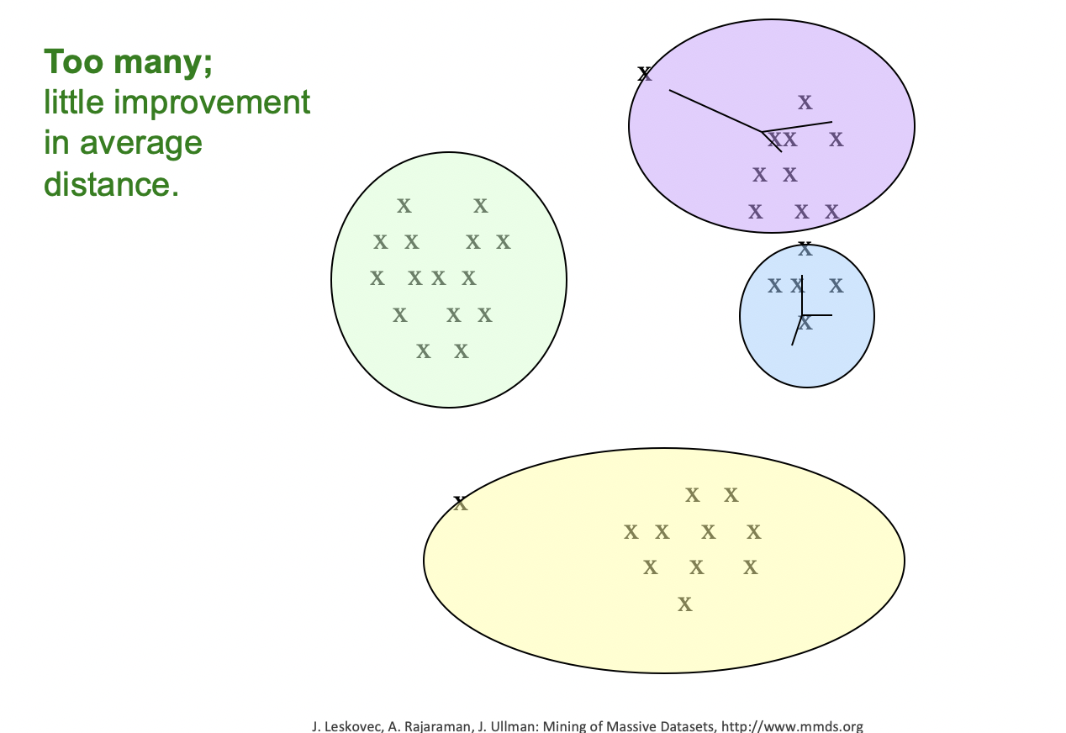
Example

Slide 39
Another way to get the right k
Silhouette
The silhouette value is a measure of how similar an object is to its own cluster (cohesion) compared to other clusters (separation). The silhouette ranges from −1 to +1, where a high value indicates that the object is well matched to its own cluster and poorly matched to neighboring clusters.
The silhouette can be calculated with any distance metric, such as the Euclidean distance or the Manhattan distance.
Notes:
If most objects have a high value, then the clustering configuration is appropriate. If many points have a low or negative value, then the clustering configuration may have too many or too few clusters.

Slide 40
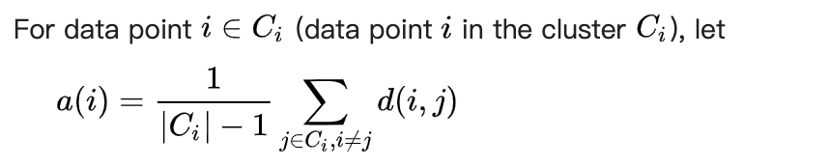
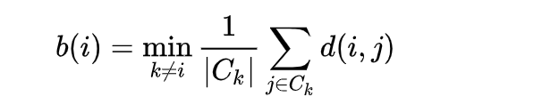
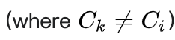
Definition of Silhouette
The mean distance between i and all other data points in the same cluster and other cluster.
Notes:
Silhouette (similar:outline)

Slide 41
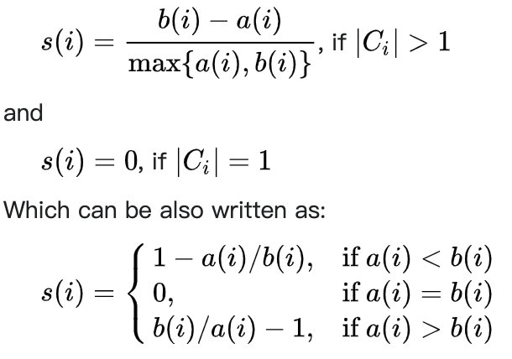
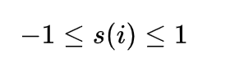
Silhouette

Slide 42
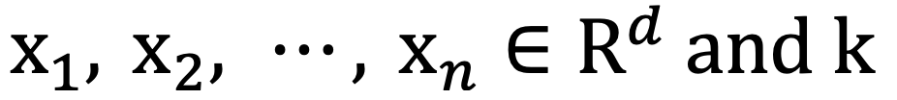
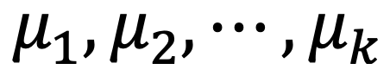
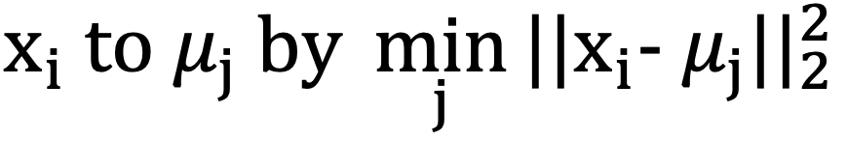
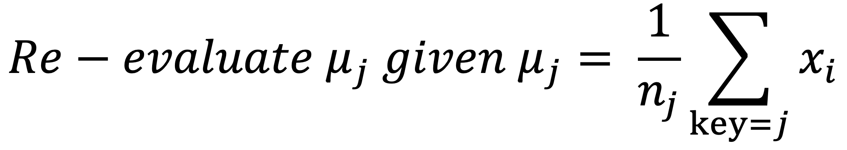
MapReduce for k-means
Given
Initialize and keep as a global variable.
In each iteration:
Map: find optimal assignments of
the key value pair is (j, xi)
Reduce:
Notes:
recalculate the cluster center as mean of assigned points

Slide 43
Pros and Cons of k-means
Advantages:
Relatively simple to implement.
Scales to large data sets. (Time complexity = O(N))
Guarantees convergence.
Can warm-start the positions of centroids.
Easily adapts to new examples.
Generalizes to clusters of different shapes and sizes, such as elliptical clusters.
Source:https://developers.google.com/machine-learning/clustering/algorithm/advantages-disadvantages

Slide 44
Pros and Cons of k-means
Disadvantages:
Choosing k manually
Being dependent on initial values
Clustering data of varying sizes and density
Clustering outliers
Source:https://developers.google.com/machine-learning/clustering/algorithm/advantages-disadvantages
Notes:
1.Use the “Loss vs. Clusters” plot to find the optimal (k).
2.For a low k, you can mitigate this dependence by running k-means several times with different initial values and picking the best result. As k
increases, you need advanced versions of k-means to pick better values of the initial centroids (called k-means seeding).
3.k-means has trouble clustering data where clusters are of varying sizes and density. To cluster such data, you need to generalize k-means as described in the Advantages section
4.Centroids can be dragged by outliers, or outliers might get their own cluster instead of being ignored. Consider removing or clipping outliers before clustering.

Slide 45
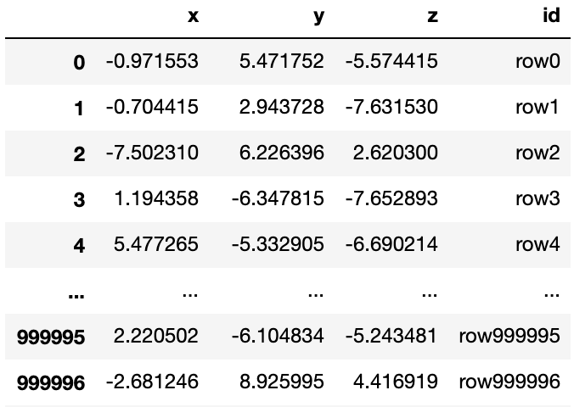
Large scale k-means (based on spark)
Dataset
Using make_blobs function to generate 10 isotropic Gaussian blobs for clustering.

Slide 46
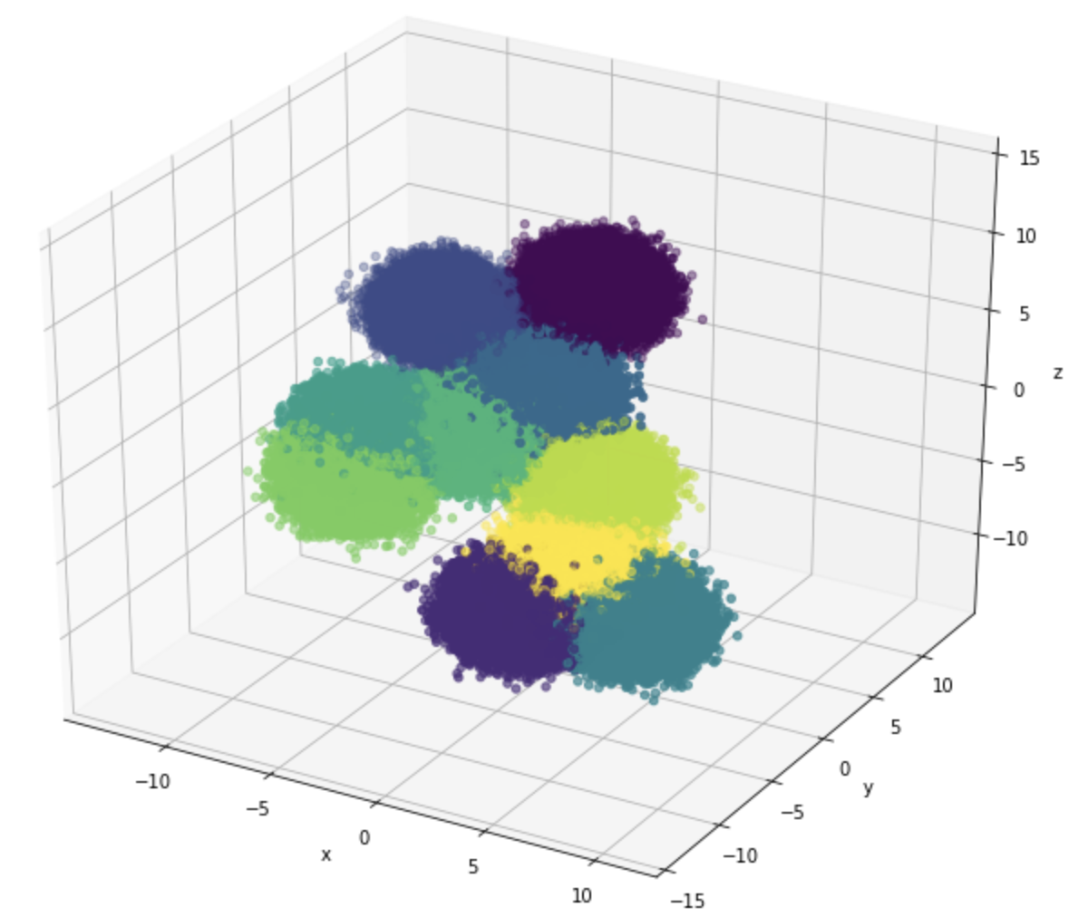
Visualization of the dataset
the true type of each data point is represented by a unique color

Slide 47
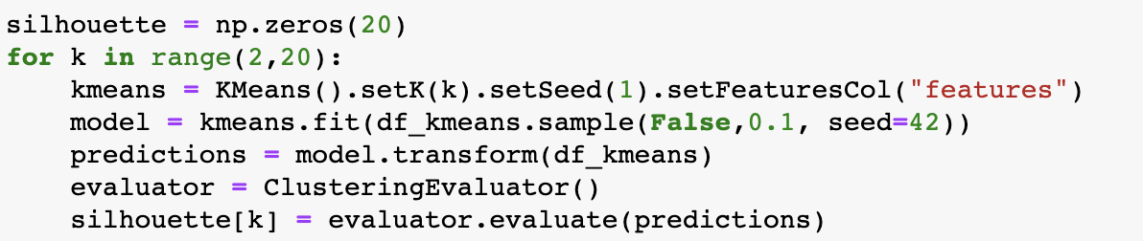
Optimize choice of k
We use “for” loop to get the silhouette for each k. k from 2 to 20.

Slide 48
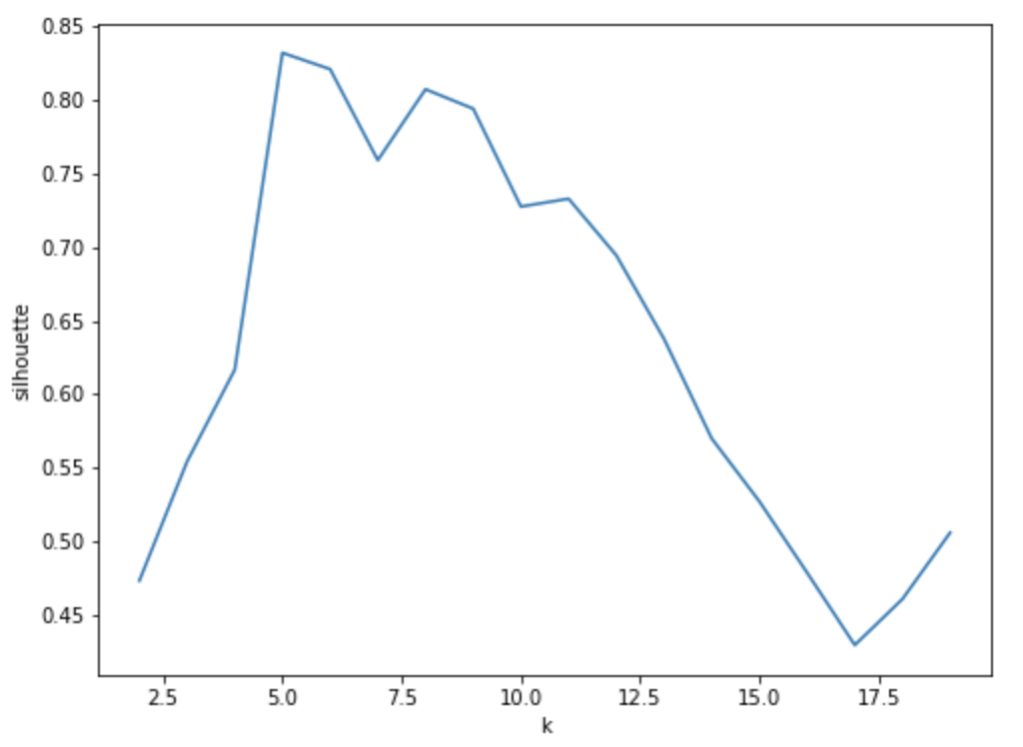
Plot silhouette
When k = 5
Get the maximum value of silhouette

Slide 49
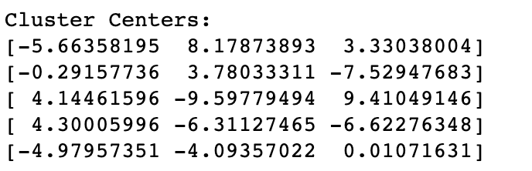
Centroids
Set k = 5 to get the centroids for the 5 clusters

Slide 50
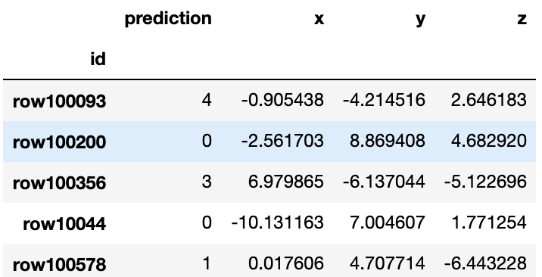
Result
Join our prediction to the dataframe.

Slide 51
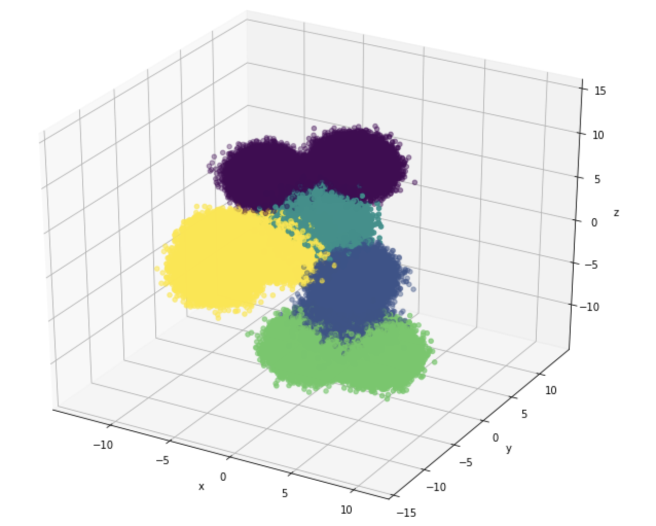
Visualize the results
Although it’s not be 10 clusters as we build the dataset.
But it looks good to get clear clusters.

Slide 52
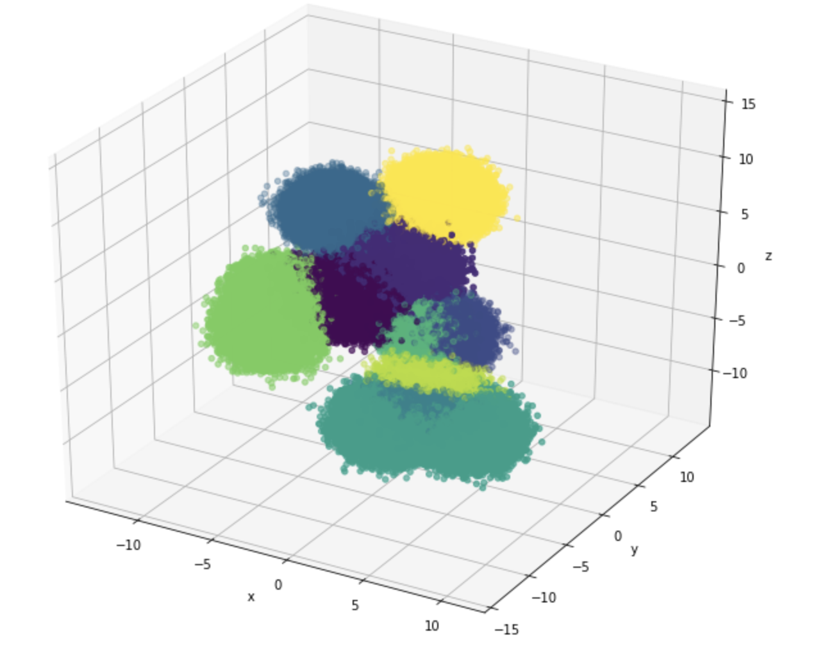
Visualize the results
If we set k = 10
as how we build our dataset
The result is not good as k = 5

Slide 53
Why
We created 1 million data points in our dataset. Too many data points may lead to unclear boundary for clusters.
We use make_blobs function and set the standard deviation to be 1. It’s too large, so some clusters are mixed together.

Slide 54
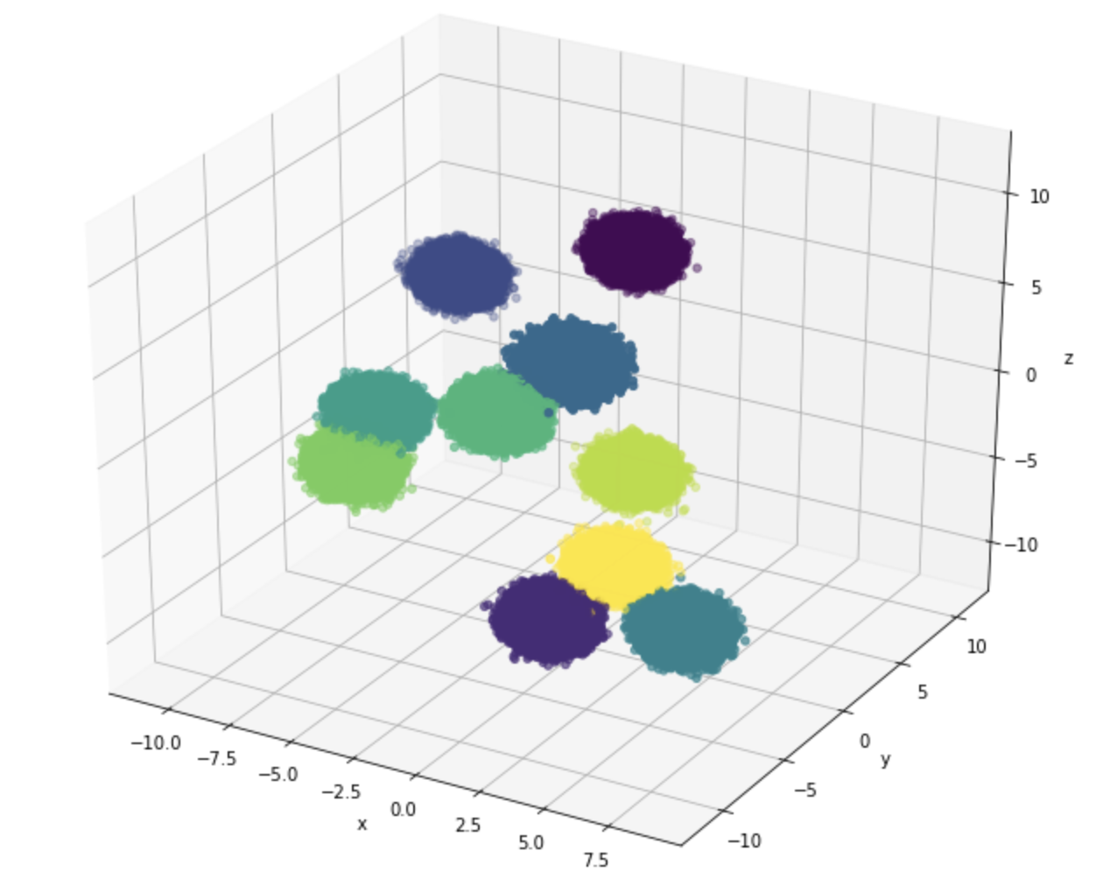
Another dataset
Set the standard deviation to be 0.5 to create another dataset

Slide 55
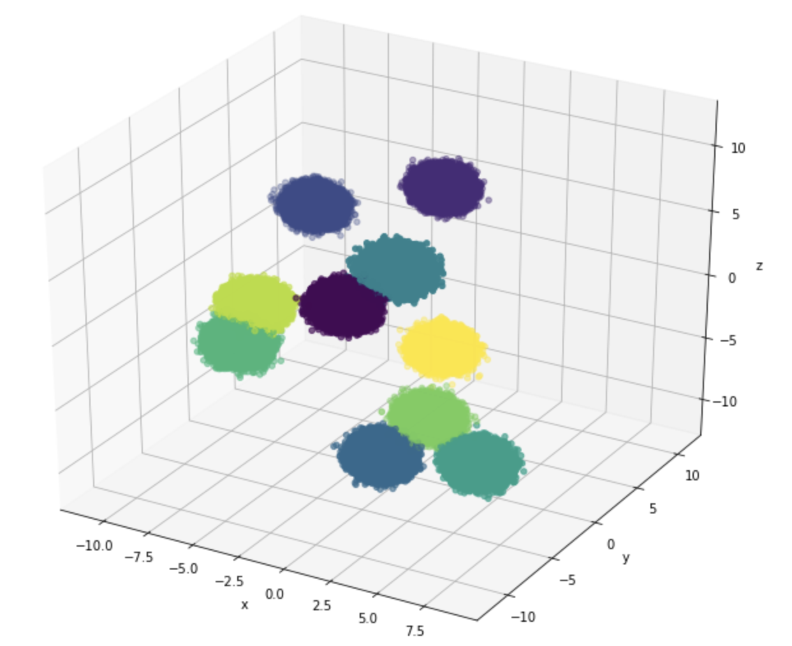
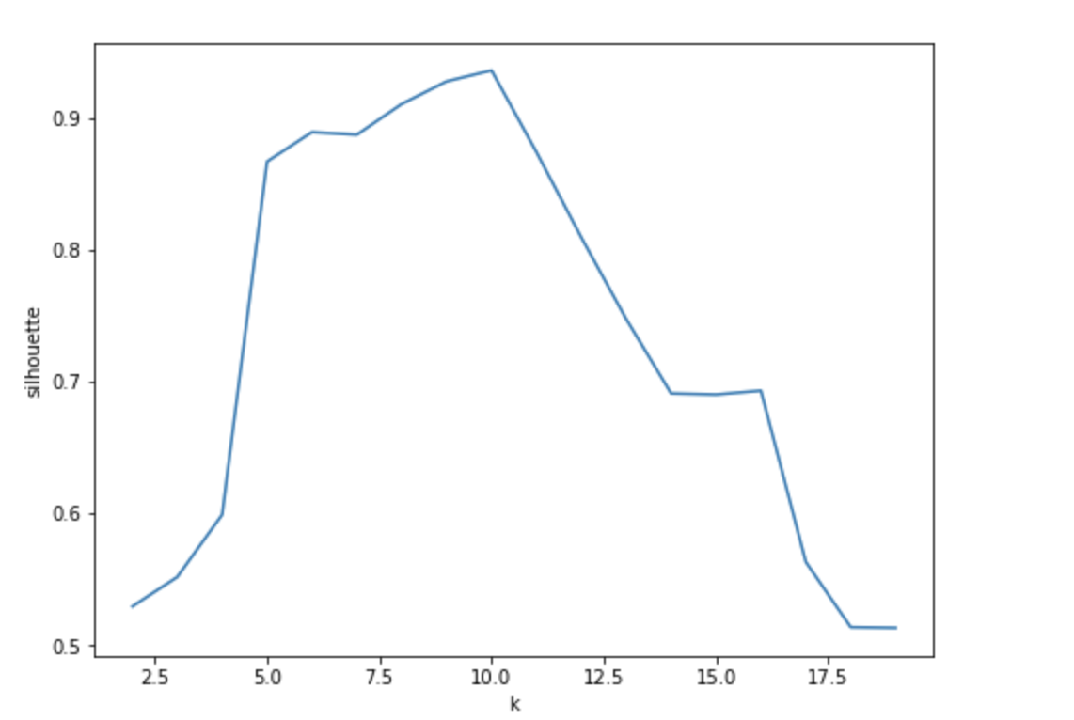
Silhouette and prediction
Notes:
The best clusters for k-means is same as what we defined. The prediction is same as what we defined.

Slide 56
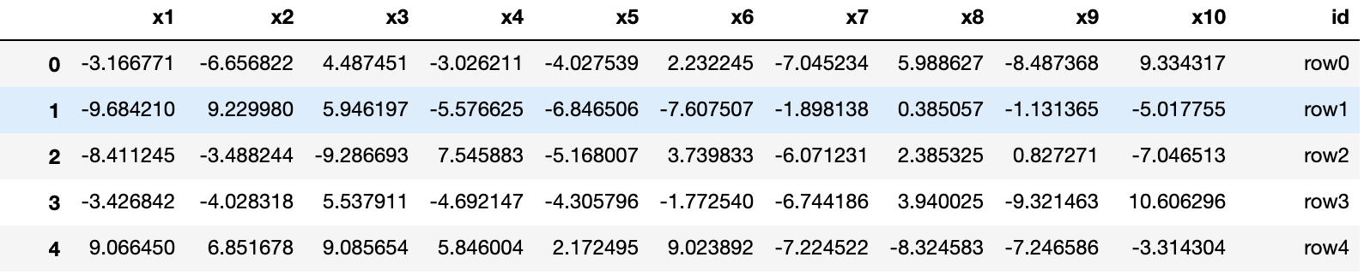
High dimension
Create a 10 dimension dataset

Slide 57
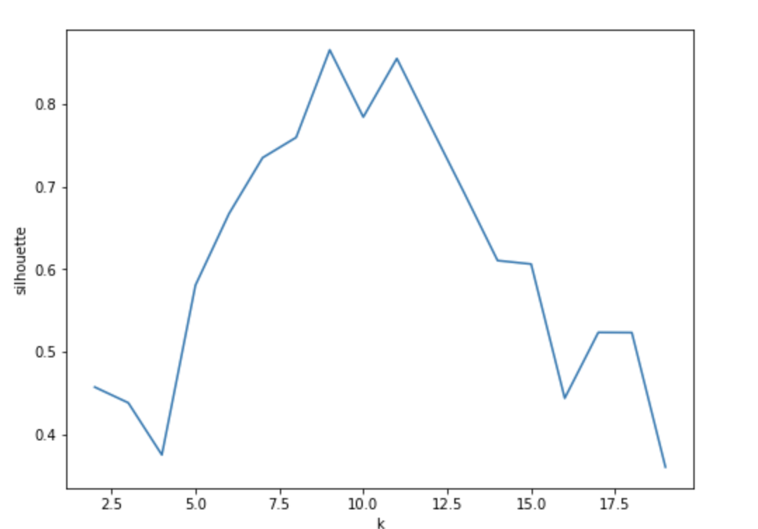
Silhouette
The best silhouette of k = 9.

Slide 58
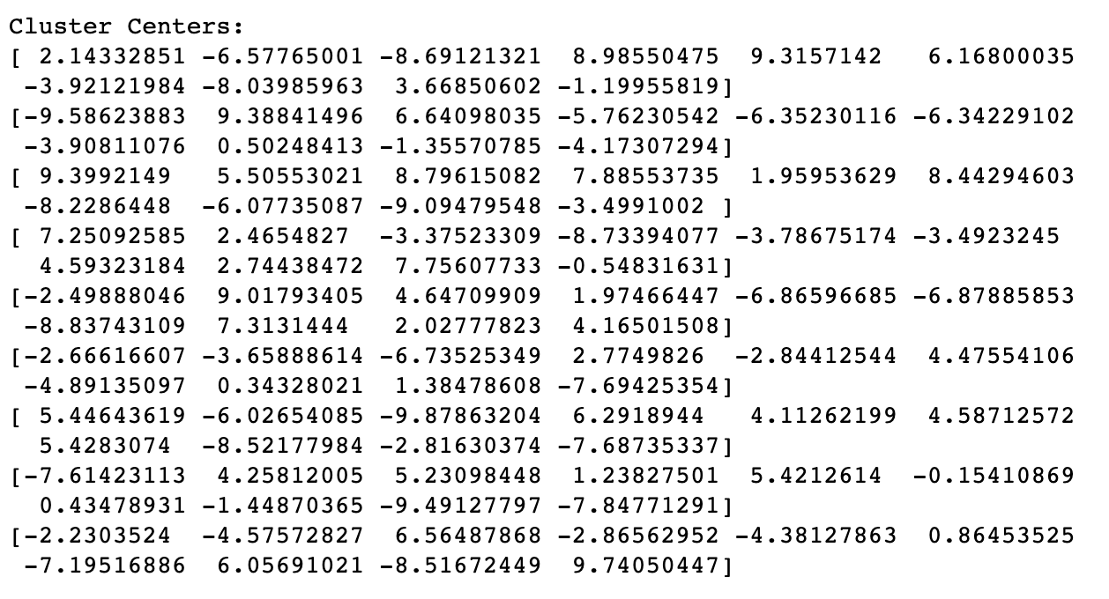
Centroid of k = 9

Slide 59
Other algorithm
BFR algorithm
CURE algorithm
K-modes
K-prototype

Slide 60
Reference
https://rsandstroem.github.io/sparkkmeans.html
https://www.geeksforgeeks.org/clustering-in-machine-learning/
https://developers.google.com/machine-learning/clustering/algorithm/advantages-disadvantages
https://en.wikipedia.org/wiki/Silhouette_(clustering)

Slide 61
Thank you!

